Slide 1
Key Priorities for Fuel Quality Developments in Asia
By Clarence Woo
Executive Director
24 November 2014
Cairo, Egypt
Notes:
1
Good morning distinguished guests and friends.
The global energy landscape is changing rapidly, given the developments in the oil & gas industry.
Many of us have come from all over the region to gather here to share and exchange knowledge and ideas on how we can develop possible roadmaps for the application of cleaner fuels and vehicle standards for a better environment.
ACFA is proud to support this endeavour.
My name is Clarence Woo, Executive Director of Asian Clean Fuels Association. [CLICK SLIDE]

Slide 2
Who is ACFA?
Working closely with fuel policymakers,
regulators and stakeholders in the fuel industry,
ACFA promotes and advances the use of
cleaner automotive fuels based on principles of
sound science, cost efficiency and
sustainability of the environment.
Notes:
2
For those who are unfamiliar with ACFA, allow me to briefly introduce us.
ACFA is a not-for-profit trade organisation that promotes the use of cleaner automotive fuels. Our core principles are sound science and technology, cost efficiency and environmental sustainability.
Since our establishment in 2000, we have been working closely with policymakers and regulators in Asia and the Middle East to develop fuel legislation and programs that support the use of cleaner fuels to improve air quality.
We believe the use of cleaner fuels is one of the compelling answers to improving air quality in a prevalent and immediate basis. [CLICK SLIDE]

Slide 3
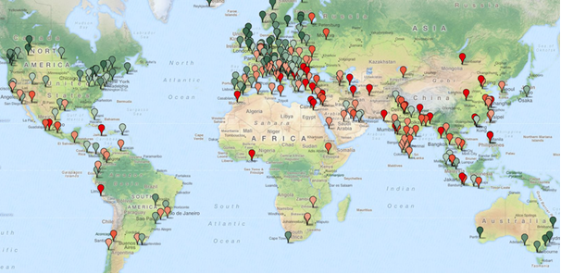
Asia and Middle East cities most polluted
Notes:
No matter what report and statistic one looks at, major Asian cities are still ranked high in the top quartile of the most pollutant cities in the world.
Without going through the wide range of air pollution indices, looking at the 2014 world pollution index map, you can see a clear focus of red spots in Asia and the Middle East.
Green is the prevailing colour in Europe and the U.S., representing a significantly better pollution standard, while South America shows a mixed bag.
South-East Europe will gradually become “greener” over time, hand in hand with the implementation of higher emission standards.

Slide 4
Need for better fuel standards?
The world pollution map is a matching image of the air emission standards applied in those countries.
Up to 90% of a city’s pollution is caused by vehicles.
Pressing need for countries in Asia and the Middle East to improve their fuel standards.
Transportation fuels are a main contributor to PM2.5.
Health concerns make emission standards an important factor to governments around the world.
Notes:
The pollution map previously shown is based on data provided by the World Health Organization (WHO) and some other relevant publications.
The world pollution map is a matching image of the air emission standards applied in those countries and underlines the need for countries in Asia and the Middle East to improve their fuel standards.
According to the Yale University Environment Performance Index 2014, only 64% of the countries worldwide meet the target for Air Pollution Average Exposure to PM2.5.
Transportation fuels are a main contributor to PM2.5, and health concerns make emission standards an important factor to governments around the world.

Slide 5
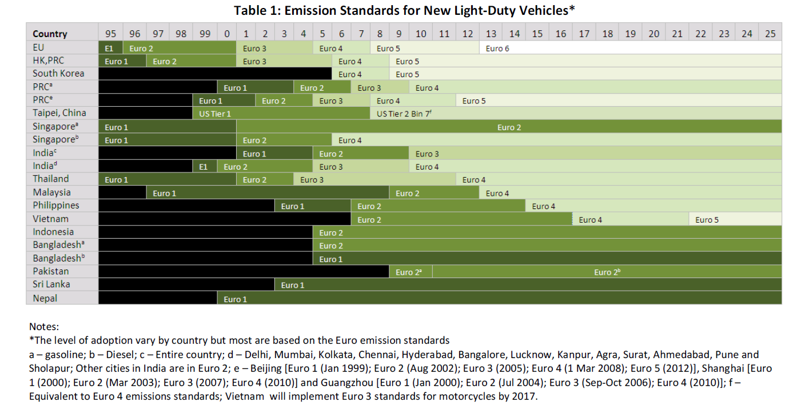
Emission standards (New Light Duty Vehicles)
Source: CAI-Asia. September 2011
Notes:
I want to give you a sense of the development of fuel quality standards in Asia.
Based on the table provided by Clean Air Asia, vehicle emission standards in Asia appear to be fragmented and need to be harmonized.
After South Korea, Hong Kong and Taiwan emerged as front runners in terms of setting new, better pollution standards. We can now see some other countries like China taking the initiative, making the need for improvement in air quality very high on their agenda.

Slide 6
Singapore
June 2014 – MEWR/NEA announced new national fuel specifications for Singapore.
Mirrors Euro 5 standards.
Will take into effect in 2017.
Notes:
For example, this year, Singapore announced that it will be adopting a new national fuel specification in 2017. The new national fuel specication parallels Euro 5 standards.
The Singapore government has engaged ACFA for technical support and advice for many years in this project.

Slide 7
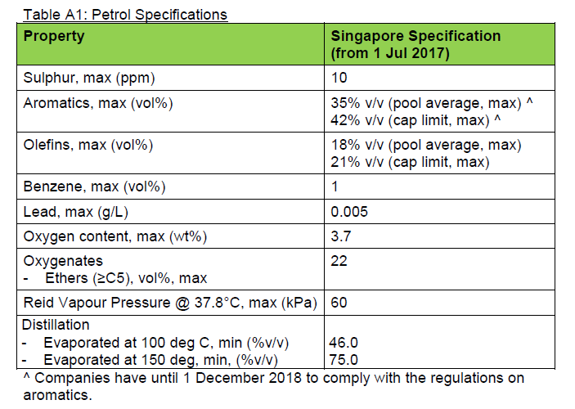
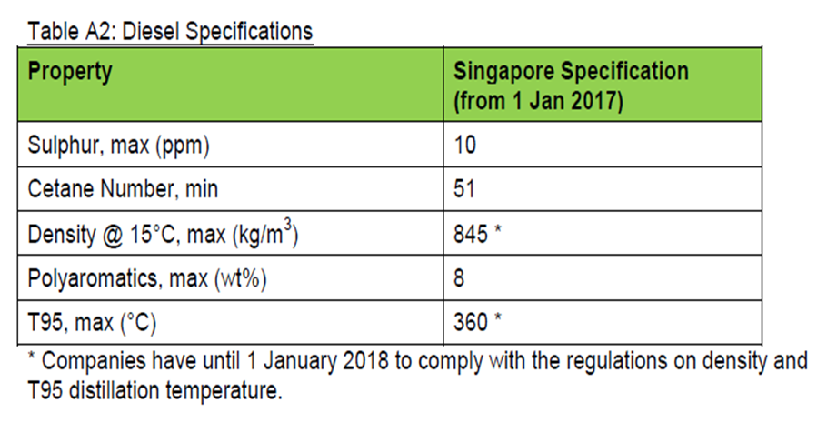
Parameters for new fuel specifications
Notes:
As you can see, this is the new fuel specifications for Singapore.

Slide 8
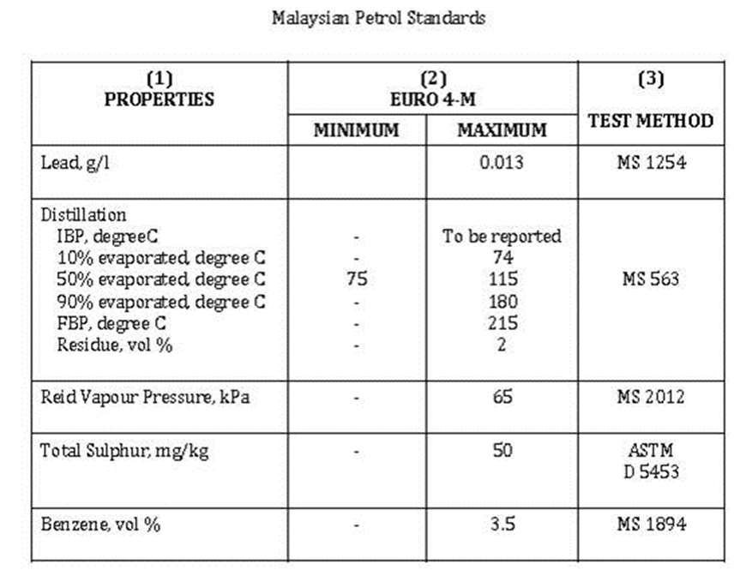
Malaysia
June 2015 deadline for nationwide switch to Euro 4-M specifications.
Sulfur limit to 50ppm from 500ppm.
Benzene level lowered to 3.5% from 5%.
RVP reduced to 65 kPa from current 70 kPa
* Euro 4-M specification does not include olefins and aromatics.
Discussions on adopting Euro 5 fuel standards after Singapore’s announcement.
Notes:
This year as well, Malaysia announced its Euro 4M fuel specification. They are targeting to push for its adoption by June 2015.
The Euro 4M has significant regulations for sulphur , benzene and RVP.
There can be more improvements to the Euro 4M standards, but this is a good start for Malaysia.
Additionally, there were discussions on the adoption of Euro 5 fuel standards in Malaysia after Singapore’s announcement on its new national fuel standards.

Slide 9
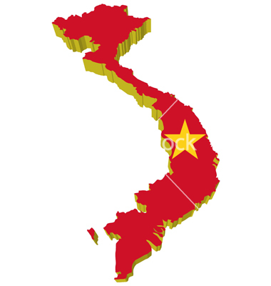
Vietnam
Plans for massive refinery expansion by 2017 to reduce reliance on imports and lower fuel price.
Adoption of Euro 4 fuel standard by 2017.
Adoption of limits to illegal/harmful chemicals used in gasoline blending.
According to the Vietnam (Petrolimex) specifications for its imported gasoline, no NMA, butyl-acetate and ketone is allowed to be blended in gasoline.
Notes:
Other positive developments in Asia can be found in Vietnam where they have announced the adoption Euro 4 fuel standard by 2017.
Vietnam also has one of the most stringent fuel standard in Asia, where harmful chemicals have recently been banned from use in its gasoline.
There are a lot of indiscriminate use of illegal chemicals in gasoline blending. We would like the Middle East policymakers to be aware of these practices.
The banned products include NMA (n-methylaniline), secondary butyl acetate and acetone.
These products are similarly banned in Europe, as they have been suspected to be the cause of fuel-related engine damages in cars.

Slide 10
China
China announced the implementation of the new GB-V national standards for vehicle-use gasoline.
The implementation of the new standard is meant to be completed by January 1, 2018.
The GB-V standard almost exactly matches the Euro 5 standard, and the key changes compared to GB-V are:
Sulphur
From 50 ppm to 10 ppm
Vapour pressure
45-85 kpa for winter gasoline
40-65 kpa for summer gasoline
Octane grades
From 90, 93 and 97RON to 89, 92, 95 and 98RON
Notes:
On December 18, 2013 the Chinese government announced the implementation of the new GB-V national standards for vehicle-use gasoline. The implementation of the new standard is meant to be completed by January 1, 2018. However, many major cities in China have already adopted the Euro-5 equivalent standards in the country.
The GB-V standard almost matches the Euro 5 standard, and the key changes compared to GB-V are:
The maximum sulphur level in gasoline will be reduced from 50 parts per million (ppm) to 10 ppm.
The maximum olefin content will be reduced from 28% to 24%.
The vapour pressure is set at 45-85 kpa for winter gasoline and 40-65 kpa for summer gasoline, slightly tighter than the GB-IV standard.
All these measures are expected to contribute to a reduction in emissions and better air quality.
ACFA is currently working with the Chinese Ministry of Environment Protection to develop new China VI standards.

Slide 11
Higher octane grade gasoline for fuel economy
Notes:
As I’ve been made aware that one of the key discussion topic for this policy meeting is on fuel economy, I thought it is useful to share with you some of the latest key findings from the Japanese Automobile Manufacturers Association.

Slide 12
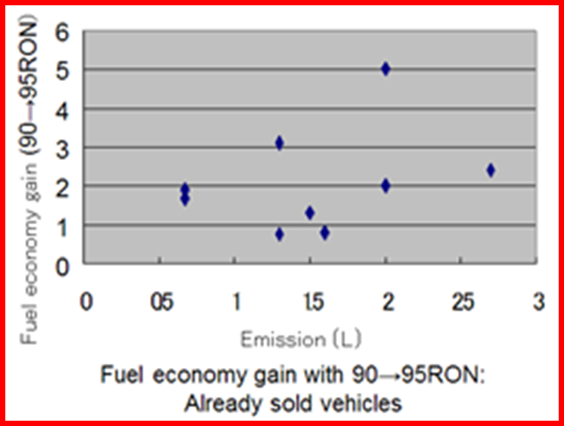
Fuel efficiency improvements
Fuel efficiency will improve by 2-8% by upgrading 90 RON to 95 RON gasoline with up to 8% for supercharged engines and 2-4% for conventional engines.
Notes:
JAMA’s study on the comparison between the use of gasoline with 90 and 95 RON grades, highlights that there are significant fuel efficiency performance.
This first chart shows that the engine efficiency improves with higher octane gasoline.
According to the study, fuel efficiency will improve by 2-8% by upgrading regular gasoline of 90RON to 95 RON premium gasoline, with up to 8% for supercharged engines and 2-4% for conventional engines.

Slide 13
Conclusions
We need commitment from countries and governments to commit to better fuel standards at this meeting.
UNEP, CEDARE, LAS, ACFA and other similar organisations can assist to help governments map out their own fuel quality roadmap.
Not only contribute to better air quality, but also benefit countries economically and ensure energy security.
Notes:
Distinguished guests and friends.
We are hopeful that this policy meeting can lead to positive commitments from participating countries and governments conference to commit to better fuel standards.
ACFA is always at your service and available to assist you if any technical support is needed.
Having better fuel standards not only contribute to better air quality, but it also will benefit countries economically in the long run and ensure energy security.
We look forward to our profitable discussions over the next 2 days.
Thank you very much.

Slide 14
Thank You

